Slide 1
Transactions and TCL
Dr. Awais Ahmed

Slide 2
Introduction - Transaction
A transaction is a sequence of operations performed as a single logical unit of work. It is used to ensure data integrity in case of errors, power failures, or other disruptions.
TCL Commands Overview:
COMMIT: Saves the changes made during a transaction.
ROLLBACK: Reverts the changes made during a transaction.
SAVEPOINT: Sets a point within a transaction to which a rollback can occur.

Slide 3
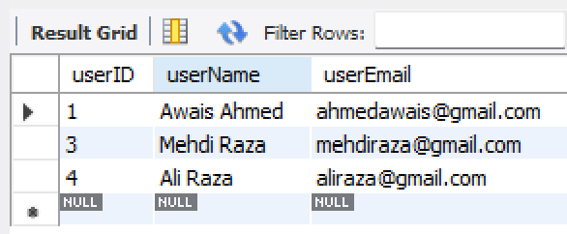
-- Step 1: Create database and switch to it
CREATE DATABASE testTransaction;
USE testTransaction;
-- Step 2: Create table 'users'
CREATE TABLE users (
userID INT AUTO_INCREMENT PRIMARY KEY,
userName VARCHAR(50),
userEmail VARCHAR(250)
);
-- Step 3: Insert initial records
INSERT INTO users (userName, userEmail) VALUES
("Awais Ahmed", "ahmedawais@gmail.com"),
("Mehdi Raza", "mehdiraza@gmail.com"),
("Ali Raza", "aliraza@gmail.com");

Slide 4
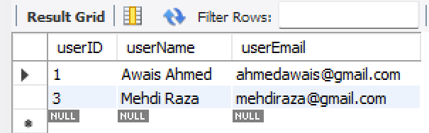
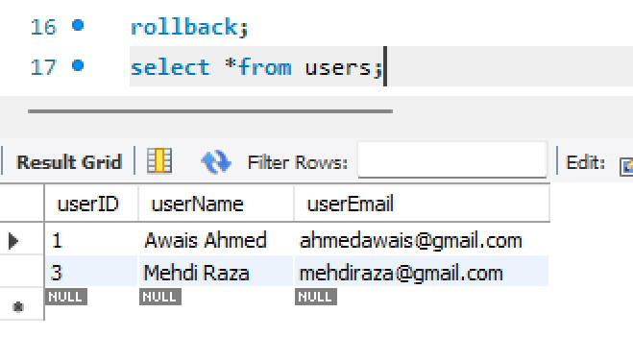
DELETE FROM users WHERE userName = 'Ali Raza';
Let’s rollback it; But no impact why?

Slide 5
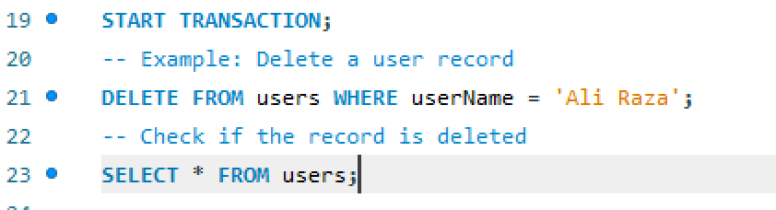
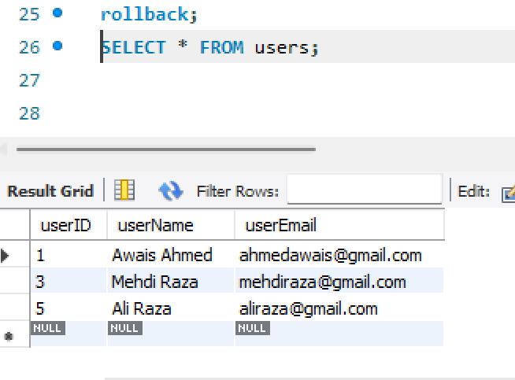
Is deletion permanently?
Let’s rollback it;
The deletion is undone because we rolled back the transaction before committing

Slide 6
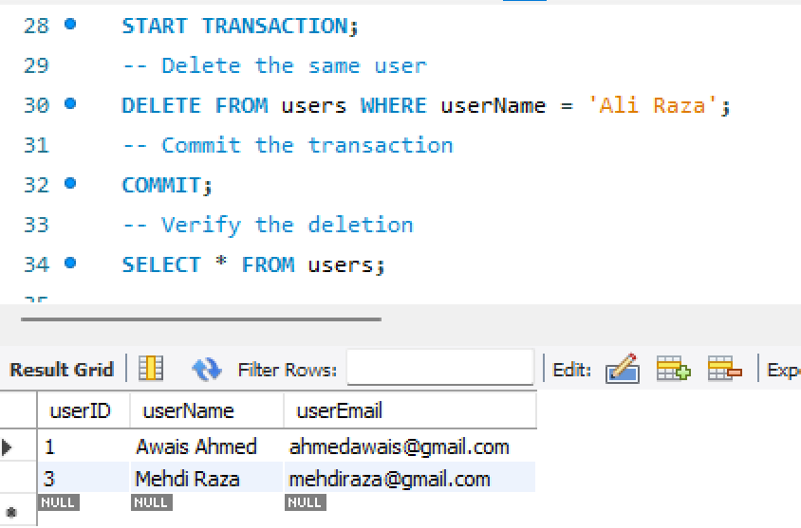
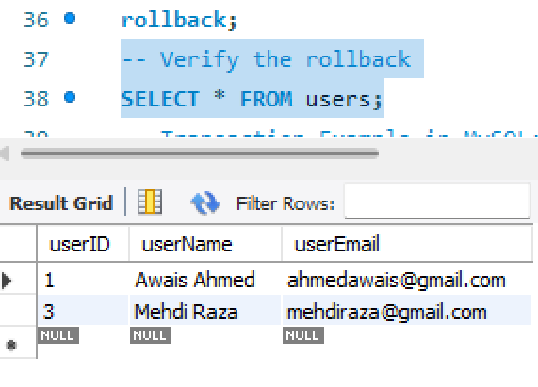
Do you want permanent deletion
Let’s commit it;
Once committed, the changes are permanent and cannot be rolled back.

Slide 7
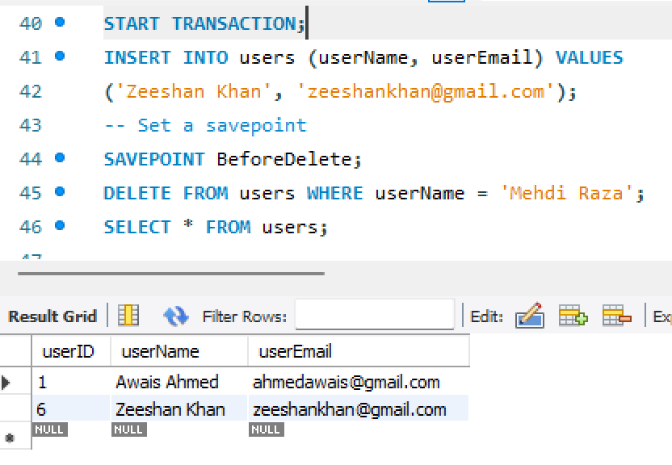
Savepoint

Slide 8
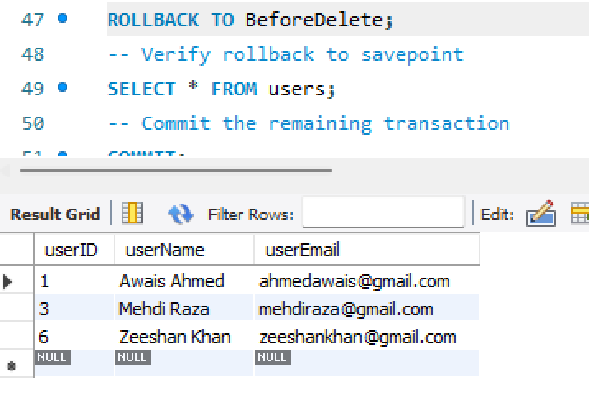
Savepoint

Slide 9
Several Read Problems in Transactions
Read Problems in Transactions: When dealing with transactions in databases, read problems can arise due to concurrent access. These problems occur when multiple transactions read and write data simultaneously, potentially leading to inconsistencies. Here are the common read problems in transactions, along with examples:

Slide 10
Isolation levels – Solution to different read problems
READ UNCOMMITED -> READ COMMITTED -> REPEATABLE READ-> SERALIZABALE (Protection is FROM MINIMUM TO MAXIMUM）
Isolation Level | Prevents Dirty Reads | Prevents Non-Repeatable Reads | Prevents Phantom Reads
READ-UNCOMMITTED | No | No | No
READ-COMMITTED | Yes | No | No
REPEATABLE READ | Yes | Yes | No* (prevented by InnoDB (mySQL engine))
SERIALIZABLE | Yes | Yes | Yes

Slide 11
Dirty Read
A dirty read occurs when a transaction reads data that has been modified by another transaction but not yet committed. If the other transaction is rolled back, the data read becomes invalid.
-- Transaction 1
START TRANSACTION;
UPDATE users SET userEmail = 'temp@gmail.com' WHERE userName = 'Awais Ahmed';
-- Transaction 2
SELECT * FROM users; -- Reads the uncommitted change from Transaction 1
rollback; -- The change to userEmail is undone
Problem: Transaction 2 read an invalid (dirty) value, leading to inconsistent results.

Slide 12
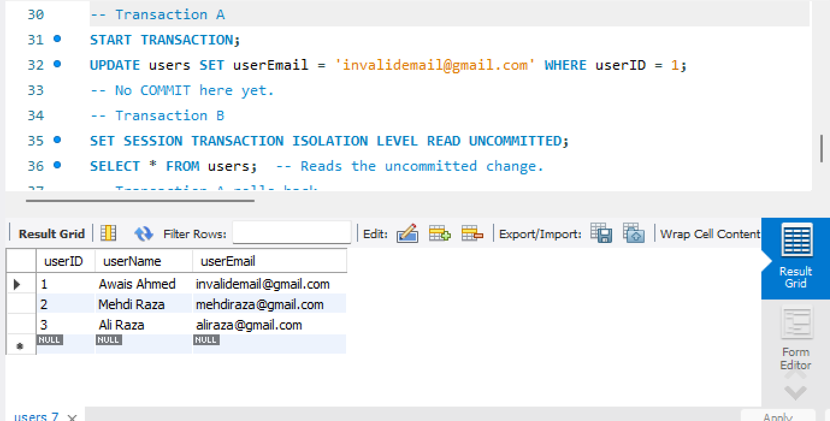
Problem: Transaction 2 read an invalid (dirty) value, leading to inconsistent results.

Slide 13
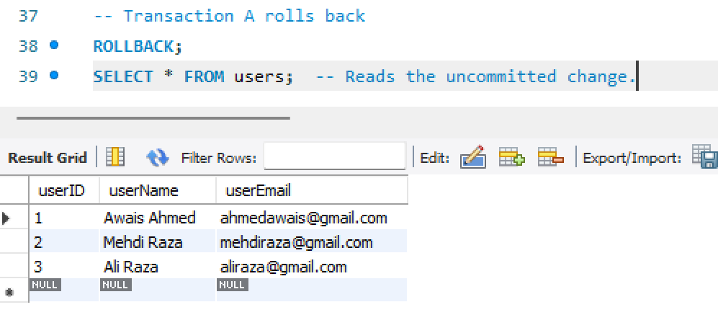
Problem: Transaction 2 read an invalid (dirty) value, leading to inconsistent results.

Slide 14
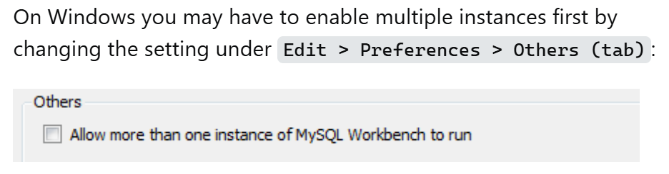
For allowing two sessions of MySQL

Slide 15
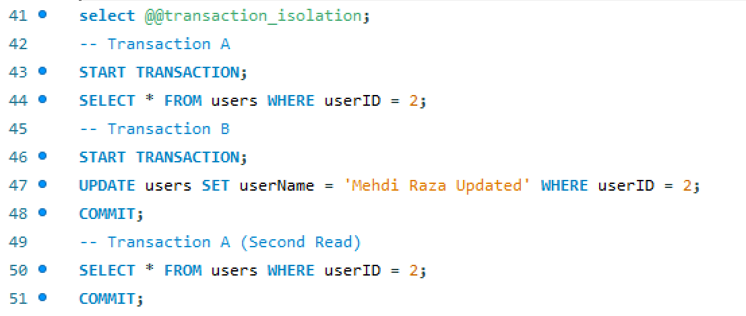
Non-Repeatable Read

Slide 16
Phantom Read
Definition: A transaction reads a set of rows that changes because another transaction inserts/deletes rows in between.
Example Scenario: Phantom Read
Transaction A queries rows based on a condition.
Transaction B inserts new rows that meet the condition.
Transaction A queries the rows again and sees "phantom (ghost)" rows.

Slide 17
READ COMMITTED;
SET SESSION TRANSACTION ISOLATION LEVEL READ COMMITTED;
Use the Read Committed isolation level to prevent dirty reads
Order of Operations: Always set the isolation level before starting transactions to ensure the desired behavior.
With PERSIST scope, transaction isolation level is not reset even after restarting MySQL:
SET PERSIST TRANSACTION ISOLATION LEVEL READ UNCOMMITTED;
SET GLOBAL TRANSACTION ISOLATION LEVEL READ COMMITTED;
https://dev.mysql.com/doc/refman/8.0/en/set-transaction.html

Slide 18
Summary
Isolation Level | Handles Dirty Read | Handles Non-Repeatable Read | Handles Phantom Read
READ UNCOMMITTED | ❌ | ❌ | ❌
READ COMMITTED | ✅ | ❌ | ❌
REPEATABLE READ | ✅ | ✅ | ❌
SERIALIZABLE | ✅ | ✅ | ✅

Slide 19
Summary
Trade-offs: Higher isolation levels ensure better consistency but come at a performance cost.
Use Cases:
READ UNCOMMITTED: Analytics (speed matters, consistency doesn't).
READ COMMITTED: Most OLTP systems (safe and fast).
SERIALIZABLE: Banking or critical systems (highest data integrity).

Slide 20
Exercise
Create a copy of your DBMS project or any other database maybe company dbms and try to attempt
Change isolation levels (READ UNCOMMITTED, READ COMMITTED, etc.)
Simulate each read problem using:
Two transactions for UPDATE, INSERT, and SELECT queries.
Observe the behavior of the database under different isolation levels.

